Slide 1


Automated Fake News Detection
Using Machine Learning and BERT
Aharon Rabson
Notes:
today I’ll be presenting my project, Automated Fake News Detection using Machine Learning and BERT. This project tackles the growing challenge of misinformation by combining both classical machine learning and deep learning approaches, with a focus on making results explainable."

Slide 2


BUSINESS PROBLEM
The spread of fake news is a major problem in our society. It can sway public opinion, influence elections, and even affect our health. Because so much information moves so quickly online, manual fact-checking just can’t keep up.
My project addresses this challenge by using machine learning and deep learning to automatically detect fake news articles, while making sure the predictions are explainable and transparent.
Notes:
The spread of fake news affects elections, public health, and trust in institutions. With the speed of online news sharing, manual fact-checking simply can’t keep up. My goal was to build an automated system that can flag potentially fake news articles while keeping transparency and interpretability at the core

Slide 3

Background / History
Fake news isn’t new, but with the rise of social media, its impact has become much more serious.
Manual fact-checking is important, but can’t handle the scale of misinformation we see today.
Machine learning models, especially those trained to pick up on language and content patterns, are now a crucial tool for detecting fake news at scale.
Notes:
Fake news isn’t new, but social media has amplified its reach and impact. Traditionally, fact-checkers review claims manually, but this can’t match the scale and speed of misinformation today. That’s where AI comes in—models can detect patterns in language and content that are difficult for humans to spot at scale.

Slide 4

DATA EXPLANATION
For this project, I used open datasets from Kaggle, which include about 40,000 news articles labeled as “fake” or “real.”
Each article has a title, full text, subject, and publication date.
To prepare the data, I removed duplicates and nulls, cleaned the text, removed stopwords, and lemmatized the words.
I also created a new column called “clean_text” for all modeling.
Notes:
I used two open datasets from Kaggle, totaling around 40,000 labeled news articles—about half labeled ‘fake’ and half ‘real.’ Each article has a title, full text, subject, and date. Data cleaning included removing duplicates, handling missing values, lowercasing, removing stopwords, and lemmatizing. I combined title and text into a single ‘clean_text’ field for analysis

Slide 5

METHODS
First, I explored the data by looking at the distribution of fake and real news, and examining the most frequent words in each category. For modeling, I used two approaches:
Classical machine learning, including TF-IDF, Logistic Regression, and Random Forests.
Deep learning, specifically the BERT transformer model, using the Hugging Face library. I also used SHAP to explain model predictions for both Logistic Regression and BERT.
Notes:
I used two modeling strategies. First, classical machine learning—TF-IDF for feature extraction, followed by Logistic Regression and Random Forests. Second, a deep learning approach using the BERT transformer model. For explainability, I used SHAP, which helps show which words influenced the prediction.

Slide 6
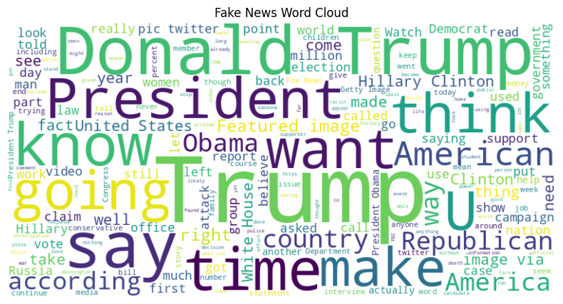
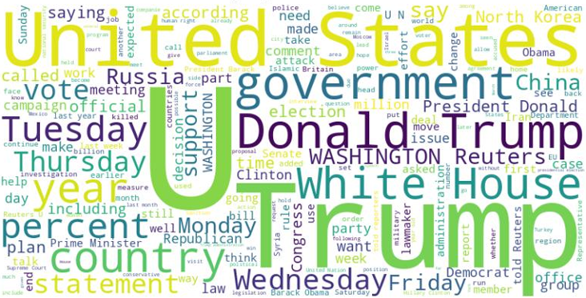
Analysis & Visuals - EDA
Fake News Word Cloud
True News Word Cloud
Fake news tends to use more viral or emotional words, while real news features agency names and more neutral language.
Notes:
Here are the word clouds. Fake news articles often use emotionally charged or viral terms like ‘video,’ ‘image,’ and ‘via.’ Real news tends to use agency names like ‘Reuters’ and location references such as ‘Washington.’ These patterns match what we’d expect from professional reporting versus clickbait-style content.

Slide 7
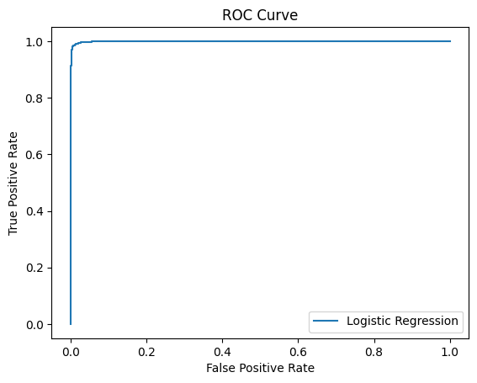
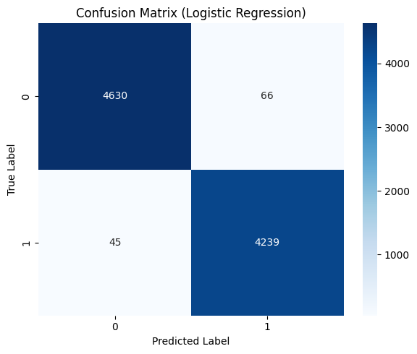
Classical Model Results
ROC Curve for Logistic Regression
Confusion Matrix
Top words for real (left) and fake (right) news
reuters: 23.589 monday: 4.781
washington reuters: 10.014 statement: 4.366
wednesday: 6.176 dont: 4.030
president donald: 5.816 spokesman: 3.953
tuesday: 5.770 nov: 3.839
washington: 5.440 minister: 3.719
thursday: 5.297 im: 3.651
friday: 4.993
reuters president: 4.794
video: -10.269 america: -4.494
image: -8.813 american: -4.481
via: -8.799 wire: -4.294
gop: -6.093 watch: -3.896
president trump: -6.091 breaking: -3.868
hillary: -6.040 president obama: -3.785
image via: -5.160
obama: -4.930
Notes:
The Logistic Regression model performed strongly, with high precision and recall. The ROC curve shows excellent separability between classes. Looking at top predictive words—real news features ‘Reuters,’ weekdays, and government terms, while fake news relies heavily on names and phrases often linked to sensationalism.

Slide 8
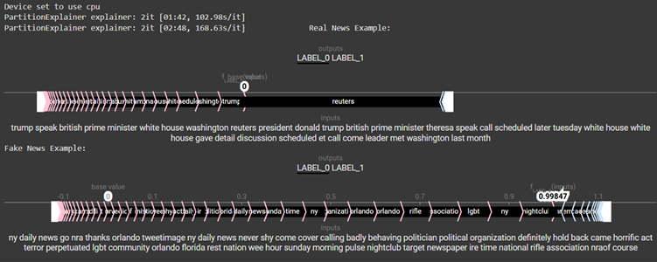
Deep Learning (BERT) Results
BERT trained on a subset due to computational constraints.
Achieved similarly high accuracy and ROC-AUC as classical models.
BERT Explainability: Used SHAP to visualize token importance for predictions (sample screenshot):
Notes:
BERT was trained on a subset due to compute limits but still matched the classical models in accuracy and ROC-AUC. SHAP visualizations for BERT show token-by-token contributions, giving us interpretability for a complex deep learning model

Slide 9

CONCLUSION, ASSUMPTIONS, & LIMITATIONS
Automated models can reliably distinguish fake from real news, even on challenging datasets.
Logistic Regression is simple and explainable, while BERT offers cutting-edge performance.
Some limitations include possible dataset bias, the 512-token limit for BERT, and the fact that SHAP can be slow for deep models.
Our approach assumes the data labels are accurate and that our preprocessing preserves the important features for classification.
Notes:
In conclusion, both Logistic Regression and BERT can accurately detect fake news. Logistic Regression is faster and more interpretable; BERT provides cutting-edge performance. Assumptions include accurate dataset labeling and effective preprocessing. Limitations include possible dataset bias and BERT’s 512-token cap.

Slide 10
Recommendations, Future Uses & Implementation
DETECTED
I recommend regularly retraining the models with new data, monitoring for bias, and combining automation with human review in high-stakes cases.
This type of fake news detector can be used for browser extensions, content moderation, and even real-time flagging.
The basic steps for implementation are:
Data cleaning
Baseline classical modeling
Deep learning with BERT
Evaluation and explainability
Deployment as an API or service
REMOVE
Notes:
I recommend regularly retraining the models with fresh data, combining AI with human review for high-impact cases, and deploying as a browser extension, content moderation tool, or API service. The implementation path is straightforward: data cleaning, baseline modeling, deep learning enhancement, explainability, and deployment.

Slide 11
ETHICAL ASSESSMENT
There are ethical risks, like bias against certain sources or topics.
I made sure no personal data was used, and all predictions are explainable with SHAP. Models should never fully replace expert human review and must disclose their limitations. Transparency and privacy are essential throughout.
Notes:
Ethically, there’s risk in bias toward certain sources or topics. No personal data was used here, and all predictions are explainable. This tool should assist, not replace, human judgment, and must be transparent about its limitations.

Slide 12
10 AUDIENCE QUESTIONS & ANSWERS
How do you define and label fake news in this study? → I used the Kaggle datasets, where articles are labeled as “fake” or “real” by human annotators.
What are the main linguistic features or words that distinguish fake from real news? → Fake news uses viral, emotional words like “video,” “image,” or “via,” while real news features agency and place names like “reuters” and “washington.”
How do classical ML and BERT compare in performance and transparency? → Both achieved high accuracy; classical ML is more transparent, while BERT offers state-of-the-art accuracy but is less interpretable—although SHAP helps with explanation.
What are the limitations or risks of deploying this model in production? → Risks include dataset bias, missing new fake news patterns, and technical limits like BERT’s input size.
How do you address possible bias or unfairness? → By using explainability tools, monitoring performance, and combining automation with human oversight.
Can this model be fooled or adversarially attacked? → Like all models, it can be tricked with adversarial inputs, so regular updates and human checks are important.
How will the model handle new fake news tactics or topics? → Regular retraining with new data is key to staying up-to-date.
Can this approach be adapted to other languages or misinformation? → Yes, with additional training data, it can work in other languages and for different kinds of misinformation.
How explainable are the predictions to non-technical users? → SHAP visualizations help show which words led to each prediction, improving trust and understanding.
What are the most important next steps to improve and deploy the system? → Expand datasets, add more diverse data, build user-friendly tools, and continuously monitor for fairness and accuracy.

Slide 13

REFERENCES & APPENDIX
I used published datasets and peer-reviewed research, all listed in my APA-style references.
The appendix includes extra figures, code, data dictionary, and supporting visuals from the analysis.
Notes:
Finally, my references are listed in APA format, and the appendix includes supporting visuals, code snippets, and the data dictionary. Thank you for your attention—happy to take any questions.

Slide 14

THANK YOU
TO CONTACT:
Aharon Rabson
Email: arabson@my365.bellevue.edu GitHub: https://github.com/Amrabson

